Slide 1
01.12.2019
Agile Enterprise BI Framework

Slide 2
Traditional approaches to BI
The need for a new approach

Slide 3






Traditional BI approaches
Corporate BI
I need insights!
Okay, I’m gonna get a dashboard to you
So… that took 2 years
BI Developer
Source System
Layer
Staging Layer
Transformation
Layer
Data Model
Layer
Report Layer
End User

Slide 4


Corporate BI
Advantages and disadvantages
High confidence over data assets
Slow to insights

Slide 5
Traditional BI approaches
Unstructured Self-Service BI (Chaos BI)
Wrong logic!
Wrong numbers!
I’m going to get my own insights
Source System
Layer
Data Model
Layer
Report Layer
End User
Overload source system
Security risk!

Slide 6
Unstructured Self-Service BI (Chaos BI)
Advantages and disadvantages
Fast to insights
Low confidence over data assets (Incorrect modelling or calculations)
Incorrect decisions
Security risk
Load on source system

Slide 7
The Solution
Agile Enterprise BI – Why not both?
Agile
Enterprise
BI
Corporate BI
Unstructured Self-Service BI

Slide 8

The Solution
Agile Enterprise BI – Why not both?
Corporate BI
Self-Service BI
BI Developer
End User

Slide 9
Agile Enterprise BI in practice

Slide 10



Agile Enterprise BI – Scenarios
Full Corporate BI
BI Developer
Source System
Layer
Staging Layer
Transformation
Layer
Data Model
Layer
Report Layer
End User
Access Control
Apply schema-based access control or access-control lists (ACL) where applicable
Row Level Security (RLS)
Apply RLS where applicable
Shared Dataset
Create certified shared dataset across domains where applicable
Row Level Security (RLS)
Apply RLS where applicable
Shared Report
Create certified shared reports across domains where applicable
Access Control
Apply schema-based access control to AAD Groups where applicable

Slide 11
Agile Enterprise BI – Scenarios
Self Service Reports
BI Developer
Source System
Layer
Staging Layer
Transformation
Layer
Data Model
Layer
Report Layer
End User
Access Control
Apply schema-based access control or access-control lists (ACL) where applicable
Row Level Security (RLS)
Apply RLS where applicable
Shared Dataset
Create certified shared dataset across domains where applicable
Row Level Security (RLS)
Apply RLS where applicable
Access Control
Apply schema-based access control to AAD Groups where applicable

Slide 12
Agile Enterprise BI – Scenarios
Self Service Data Models
BI Developer
Source System
Layer
Staging Layer
Transformation
Layer
Data Model
Layer
Report Layer
End User
Access Control
Apply schema-based access control or access-control lists (ACL) where applicable
Row Level Security (RLS)
Apply RLS where applicable
Access Control
Apply schema-based access control to AAD Groups where applicable

Slide 13

Agile Enterprise BI – Scenarios
Self Service Entities
BI Developer
Source System
Layer
Staging Layer
Transformation
Layer
Data Model
Layer
Report Layer
End User
Access Control
Apply schema-based access control or access-control lists (ACL) where applicable
Reusable entities
Create reusable entities where applicable

Slide 14
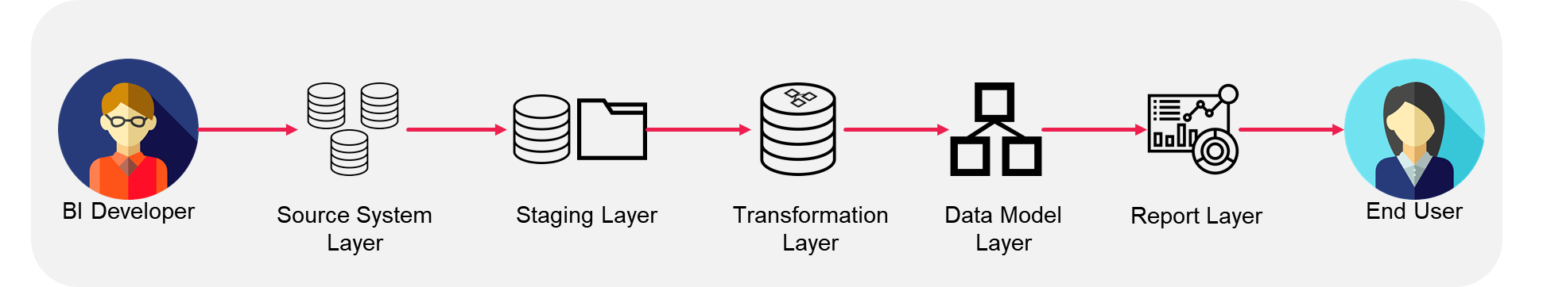
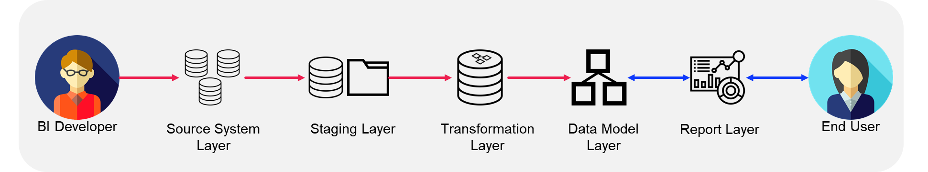


Corporate BI
How wide?
No one size fits all - varies from organization to organization
Your Organization will need to decide what scenarios to support
We recommend supporting all scenarios as that allows for most flexibility
Self Service BI
Full Corporate BI
Self Service Reports
Self Service Data Models
Self Service Entities

Slide 15
Scenarios and Technologies

Slide 16

Agile Enterprise BI All scenarios at play
Full Corporate BI
Self Service Reports
Self Service Data Models
Self Service Entities
Report Layer
Data Model Layer
Transformation Layer
Staging Layer
Source System Layer

Slide 17
Agile Enterprise BI Technologies
Below is only a suggested approach
Full Corporate BI
Self Service Reports
Self Service Data Models
Self Service Entities
Report Layer
Power BI Report
Power BI Report
Power BI Report
Power BI Report
Data Model Layer
Power BI Dataset
Power BI Dataset
Power BI Dataset
Power BI Dataset
Transformation Layer
SQL
Power BI Dataflow
Staging Layer
Data Lake or SQL
Source System Layer
Source Application

Slide 18
Agile Enterprise BI Power BI Workspace Governance
Below is only an example
Full Corporate BI
Self Service Reports
Self Service Data Models
Self Service Entities
Report Layer
Power BI Report
Power BI Report
Power BI Report
Power BI Report
Shared
Team
Team
Team
Data Model Layer
Power BI Dataset
Power BI Dataset
Power BI Dataset
Power BI Dataset
Shared
Team
Team
Team
Transformation Layer
SQL
Power BI Dataflow
Power BI Dataflow
Shared
Team
Staging Layer
Data Lake or SQL
Source System Layer
Source Application

Slide 19
Framework Components

Slide 20









Framework Components
Requirements or components that need to be implemented
Technology
Power BI Platform
Power BI Admin Monitoring and Alerts
Staging Layer
Advanced Data Protection and Privacy
Service Desk and DevOps Integration
Power BI Access Management
Transformed Layer ¹
Staging Layer
Access Management
Power BI Data Alerts
Power BI Admin Configuration
Transformed Layer Access Management
Data Cataloging
Azure AD and Employee System Integration
People
BI Developers Power BI Foundation Training
BI Developers Agile Enterprise BI Training
Power BI Advanced Transformation Training
Power BI Report Visual Design Training
Self-Service Users Power BI Training
BI Developers Develop and Deploy Training
Power BI Admin Training
Power BI Advanced Data Modelling Training
SQL Transformation Training
Process
Corporate BI Development Process
Self Service Development Process
Corporate BI End-User Requirement Gathering Process
Corporate BI Deployment Process
Self Service Deployment Process
Service Desk Ticket to Backlog Process

Slide 21
Framework Components
Components that will be implemented in Agile Enterprise BI
Technology
Power BI Platform
Power BI Admin Monitoring and Alerts
Staging Layer
Advanced Data Protection and Privacy
Service Desk and DevOps Integration
Power BI Access Management
Transformed Layer ¹
Staging Layer
Access Management
Power BI Data Alerts
Power BI Admin Configuration
Transformed Layer Access Management
Data Cataloging
Azure AD and Employee System Integration
People
BI Developers Power BI Foundation Training
BI Developers Agile Enterprise BI Training
Power BI Advanced Transformation Training
Power BI Report Visual Design Training
Self-Service Users Power BI Training
BI Developers Develop and Deploy Training
Power BI Admin Training
Power BI Advanced Data Modelling Training
SQL Transformation Training
Process
Corporate BI Development Process
Self Service Development Process
Corporate BI End-User Requirement Gathering Process
Corporate BI Deployment Process
Self Service Deployment Process
Service Desk Ticket to Backlog Process
¹ Transformed Layer will be partially implemented as Agile Enterprise BI enables Self-Service users to create their own Transformed Entity using Power BI Dataflow.

Slide 22
Framework Components
Components that will be implemented in Agile Enterprise BI
Full Corporate BI
Self Service Reports
Self Service Data Models
Self Service Entities
Report Layer
Power BI Report
Power BI Report
Power BI Report
Power BI Report
Shared
Team
Team
Team
Data Model Layer
Power BI Dataset
Power BI Dataset
Power BI Dataset
Power BI Dataset
Shared
Team
Team
Team
Transformation Layer
SQL
Power BI Dataflow
Power BI Dataflow
Shared
Team
Staging Layer
Data Lake or SQL
Not Implemented
Source System Layer
Source Application

Slide 23
Power BI Access Management

Slide 24
Power BI Content Access Management
Ways to access content
Access via content
Access via workspace

Slide 25
Power BI Content Access Management
Access via content
Power BI Workspace
Azure AD Group
Dashboard A
User A
Dashboard B
User B
Dashboard C
User C
Report A
User D
Report B
User E
Report C
User F
Dataset A
User G
Dataset B
User H
Dataset C
User I
Dataflow A
User J
Dataflow B
User K
Dataflow C
User L

Slide 26
Power BI Content Access Management
Access via workspace
Power BI Workspace
Azure AD Group
Dashboard A
User A
Dashboard B
User B
Dashboard C
User C
Report A
User D
Report B
User E
Report C
User F
Dataset A
User G
Dataset B
User H
Dataset C
User I
Dataflow A
User J
Dataflow B
User K
Dataflow C
User L

Slide 27
Power BI Content Access Management
Ways to grant access to content
Do not grant access via content
Do grant access via Workspaces
Access via content
Access via workspace

Slide 28






Power BI Workspace Roles
Workspace
Admin
Workspace
Member
Workspace
Contributor
Workspace
Viewer
App
Viewer
Function | Administer the workspace
Primary Capability | Add/remove people including admins Update app Share content Allow reshare
Suggested User Type | Power BI Admins
Function | Manage workspace and contribute content
Primary Capability | Add people with lower permissions Update app Share content Allow reshare Schedule refresh
Suggested User Type | BI Developers
Function | Contribute content
Primary Capability | Publish content Create, edit, delete content in workspace Schedule refresh Update app (if allowed)
Suggested User Type | Team Analytics Contributor
Function | View workspace content
Primary Capability | View content in workspace
Suggested User Type | N/A – we do not recommend using this role unless necessary
Function | View app content
Primary Capability | View curated content in app Grants user build permission to the dataset
Suggested User Type | Team Analytics Reader
Learn more about the new Workspace roles here.

Slide 29
Power BI Workspace Governance
Below is only an example of one organizational structure. Power BI Workspace structure should match how your organization is structured. Similar characteristics should be brought to the top as shown by the arrows below.
Organization
Power BI Organization Workspace
Division
Business Function
Workspace
Business Function
Division
Workspace
=
Team
Team
Workspace

Slide 30
How deep?
No one size fits all - varies from organization to organization
Your Organization will need to draw the lines
We recommend below where Self Service BI content can be pushed to Business Function or Organization Workspace with the support of Corporate BI
Power BI Organization Workspace
Business Function
Workspace
Corporate BI
Division
Workspace
Team
Workspace
Self Service BI

Slide 31
Power BI Workspace Access Mapping
Organization Level | Analytics Role | Azure AD Group | Power BI Collection Type | Power BI Workspace Name | Power BI Workspace Role
Business Function | Reader | <DivisionCode>-<BusinessFunctionCode>-<TeamName>-AnalyticsReader | App | <BusinessFunctionName> | App Viewer
 | Contributor | <DivisionCode>-AnalyticsContributor | Workspace | <BusinessFunctionName> | Workspace Contributor
Division | Reader | <DivisionCode>-<BusinessFunctionCode>-AnalyticsReader | App | <BusinessFunctionName>-<DivisionName> | App Viewer
 | Contributor | <DivisionCode>-<BusinessFunctionCode>-AnalyticsContributor | Workspace | <BusinessFunctionName>-<DivisionName> | Workspace Contributor
Team | Reader | <DivisionCode>-<BusinessFunctionCode>-<TeamName>-AnalyticsReader | App | <BusinessFunctionName>-<DivisionName> -<TeamName> | App Viewer
 | Contributor | <DivisionCode>-<BusinessFunctionCode>-<TeamName>-AnalyticsContributor | Workspace | <BusinessFunctionName>-<DivisionName> -<TeamName> | Workspace Contributor

Slide 32
Power BI Workspace Access Mapping
Example
Organization Level | Analytics Role | Azure AD Group | Power BI Collection Type | Power BI Workspace Name | Power BI Workspace Role
Marketing Function | Reader | AU-MKTG-Sales-AnalyticsReader | App | Marketing | App Viewer
 | Contributor | BI-<BITeamName>-Contributor | Workspace | Marketing | Workspace Contributor
Australia Division | Reader | AU-MKTG-Sales-AnalyticsReader | App | Marketing-Australia | App Viewer
 | Contributor | BI-<BITeamName>-Contributor | Workspace | Marketing-Australia | Workspace Contributor
Sales Team | Reader | AU-MKTG-Sales-AnalyticsReader | App | Marketing-Australia-Sales | App Viewer
 | Contributor | AU-MKTG-Sales-AnalyticsContributor | Workspace | Marketing-Australia-Sales | Workspace Contributor

Slide 33
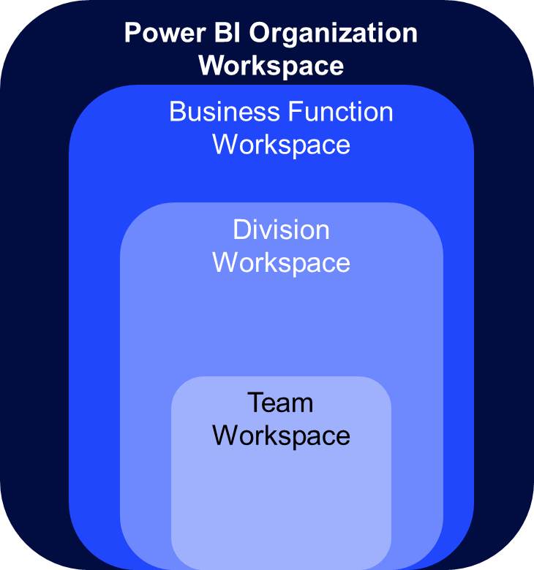
Power BI Workspace Governance
Power BI Workspace Level | Who can view? (AAD Group) | Who can contribute? (AAD Group) | Who can manage? (AAD Group)
Business Function Workspace | Members of: <DivisionCode>-AnalyticsReader <DivisionCode>-AnalyticsContributor BI-<BITeamName>-Contributor | Members of: BI-<BITeamName>-Contributor ¹ | Members of: BI-<BITeamName>-Contributor
Division Workspace | Members of: <DivisionCode>-AnalyticsReader <DivisionCode>-AnalyticsContributor BI-<BITeamName>-Contributor | Members of: BI-<BITeamName>-Contributor ¹ | Members of: BI-<BITeamName>-Contributor
Team Workspace | Members of: <DivisionCode>-<BusinessFunctionCode>-<TeamName>-AnalyticsReader <DivisionCode>-<BusinessFunctionCode>-<TeamName>-AnalyticsContributor BI-<BITeamName>-Contributor | Members of: <DivisionCode>-<BusinessFunctionCode>-<TeamName>-AnalyticsContributor BI-<BITeamName>-Contributor | Members of: BI-<BITeamName>-Contributor
¹ If self-service users wish to contribute, they will have to involve the Corporate BI stream to engage in review and deployment of the BI asset.

Slide 34
Power BI Workspace Governance
Example
Power BI Workspace Level | Who can view? (AAD Group) | Who can contribute? (AAD Group) | Who can manage? (AAD Group)
Marketing Business Function Workspace | Members of: AU-AnalyticsReader AU-AnalyticsContributor BI-Data-Contributor | Members of: BI-Data-Contributor ¹ | Members of: BI-Data-Contributor
Australia Division Workspace | Members of: AU-MKTG-AnalyticsReader AU-MKTG-AnalyticsContributor BI-Data-Contributor | Members of: BI-Data-Contributor ¹ | Members of: BI-Data-Contributor
Sales Team Workspace | Members of: AU-MKTG-Sales-AnalyticsReader AU-MKTG-Sales-AnalyticsContributor BI-Data-Contributor | Members of: AU-MKTG-Sales-AnalyticsContributor BI-Data-Contributor | Members of: BI-Data-Contributor
¹ If self-service users wish to contribute, they will have to involve the Corporate BI stream to engage in review and deployment of the BI asset.

Slide 35
Agile Enterprise BI
Width and Depth Recap

Slide 36
Corporate BI
How wide?
No one size fits all - varies from organization to organization
Your Organization will need to decide what scenarios to support
We recommend supporting all scenarios as that allows for most flexibility
Self Service BI
Full Corporate BI
Self Service Reports
Self Service Data Models
Self Service Entities

Slide 37
How deep?
No one size fits all - varies from organization to organization
Your Organization will need to draw the lines
We recommend below where Self Service BI content can be pushed to Business Function or Organization Workspace with the support of Corporate BI
Power BI Organization Workspace
Business Function
Workspace
Corporate BI
Division
Workspace
Assist Self Service BI to deploy and validate content for Business Function Workspace and above
Team
Workspace
Self Service BI

Slide 38
Development and Deployment

Slide 39



Corporate BI Developer
Power BI Content – Development and Deployment Process
1
2
BI Developer
Power BI Desktop (.pbix)
Development Workspace
3
Pull Request
Commit Trigger
Deploy
Publish App
Validate
4
5
6
7
Azure DevOps
Repos
Azure DevOps
Pipelines
UAT Workspace
UAT App
End User
Approval Gate
Deploy
Publish App
Consume
8
9
10
11
Azure DevOps
Pipelines
Production Workspace
Production App
End User

Slide 40
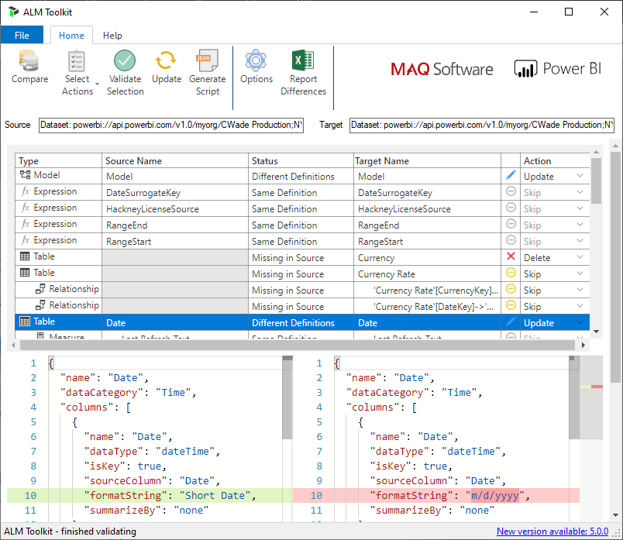
Corporate BI Developer
Review Pull Requests

Slide 41
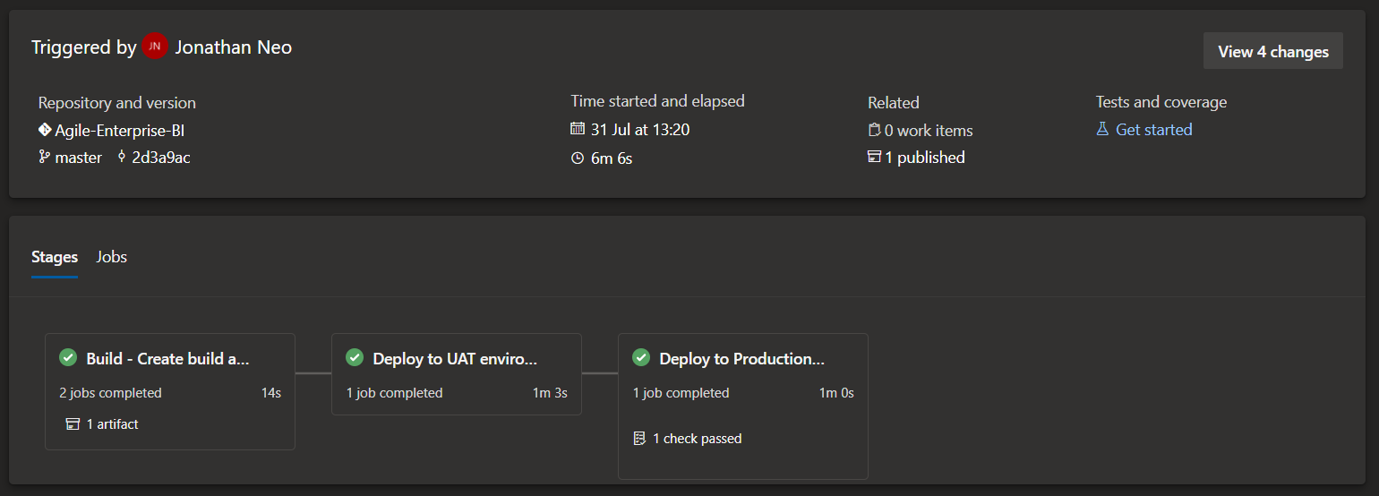
Corporate BI Developer
YAML Pipeline to facilitate deployment to multiple environments

Slide 42


Self Service Developer
Power BI Content – Development and Deployment Process
1
2
Self Service Developer
Save
Power BI Desktop (.pbix)
SharePoint or OneDrive
3
Publish
Review
4
Production Workspace
Self Service Developer
5
Update App
Consume
6
Production App
End User

Slide 43
Power BI Monitoring and Alerts

Slide 44
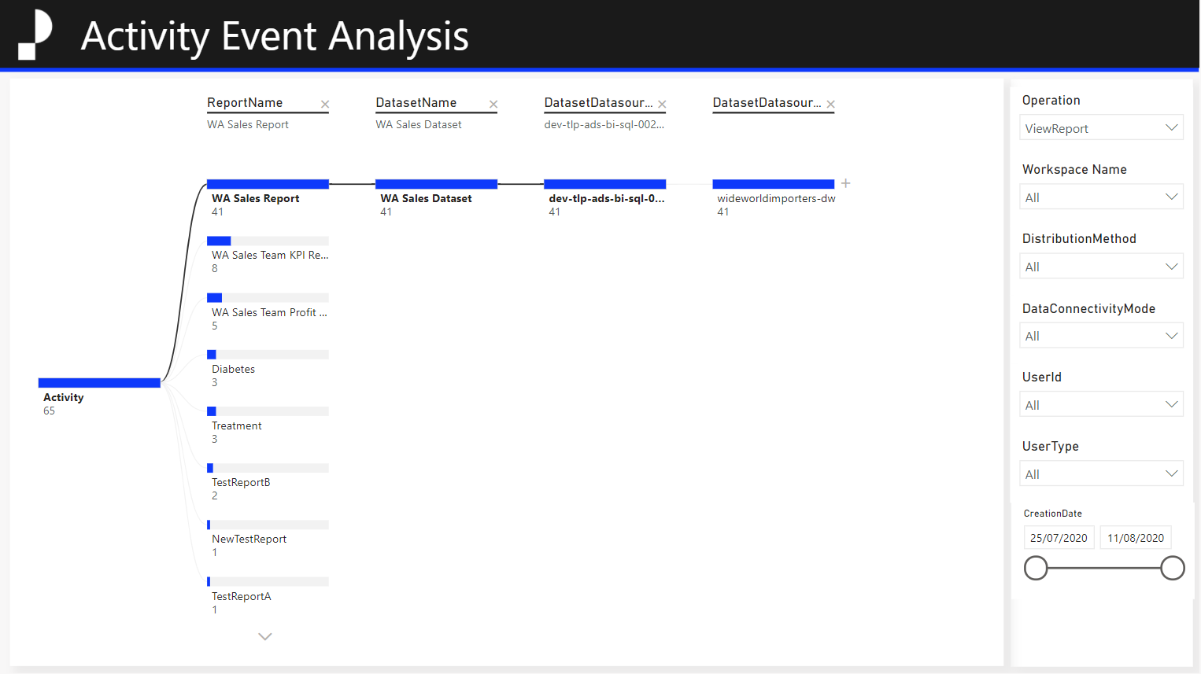
Monitoring
Demand and impact analysis
Discover high demand assets across tenant
Perform impact analysis across tenant based on usage

Slide 45
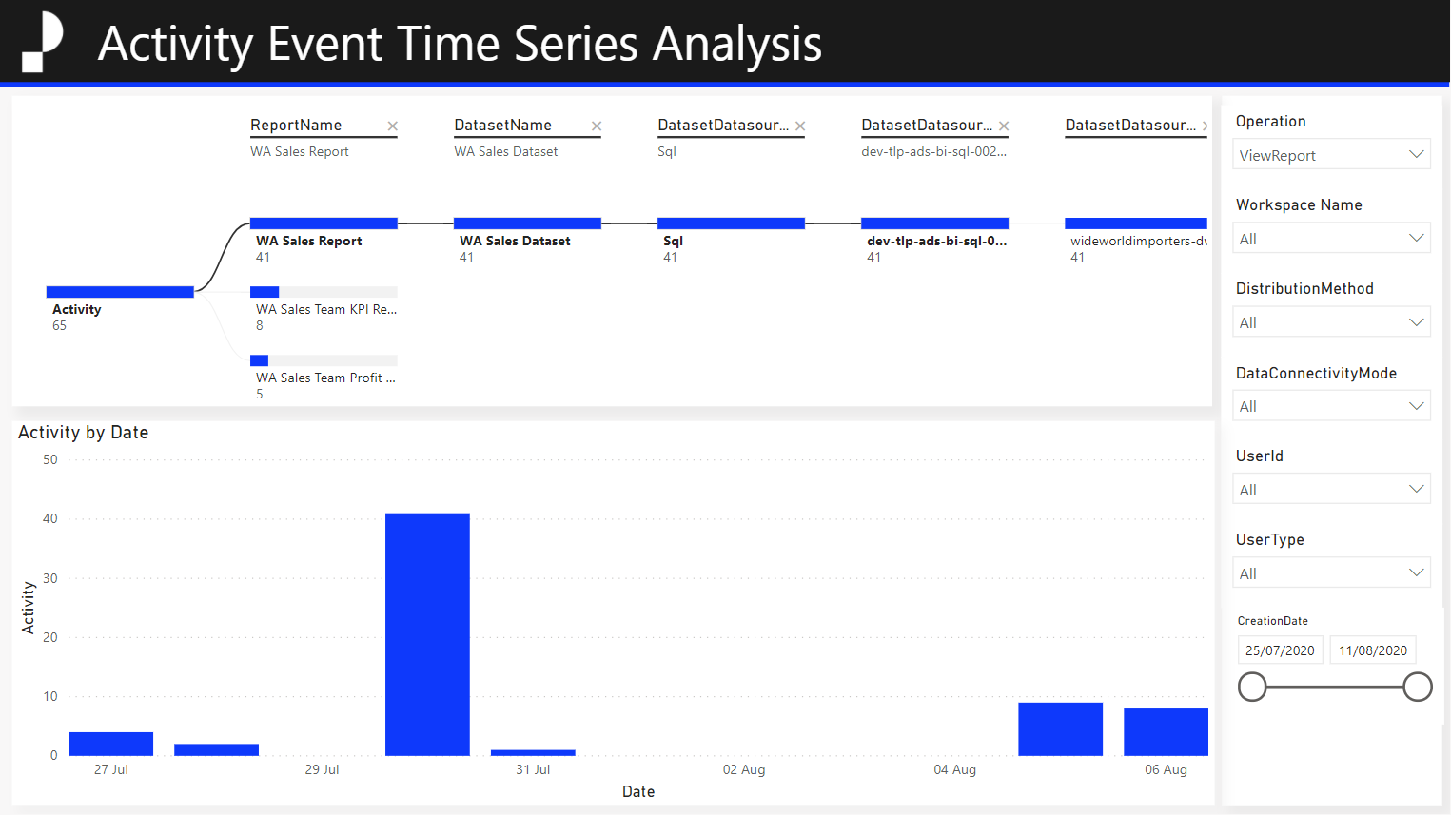
Monitoring
Time series analysis
Visualize usage time series data across tenant

Slide 46
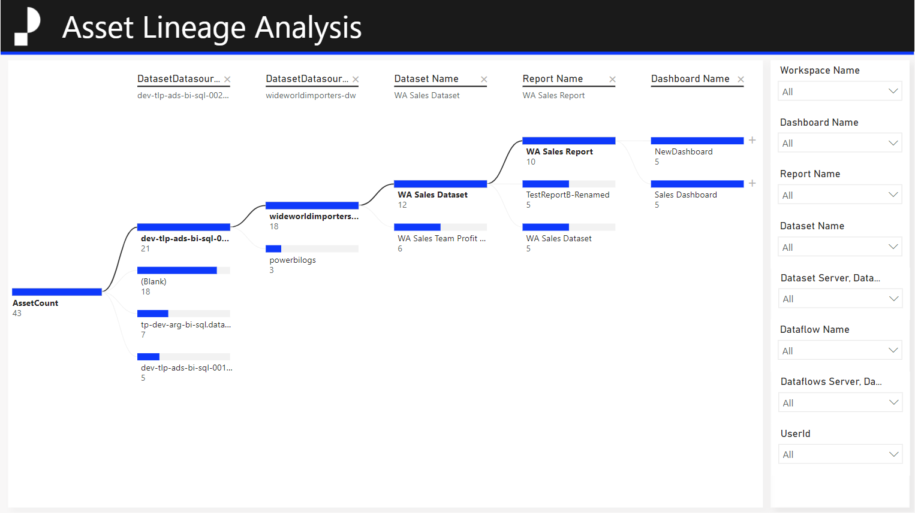
Monitoring
Impact analysis
Perform impact analysis across tenant from data source to dashboard

Slide 47
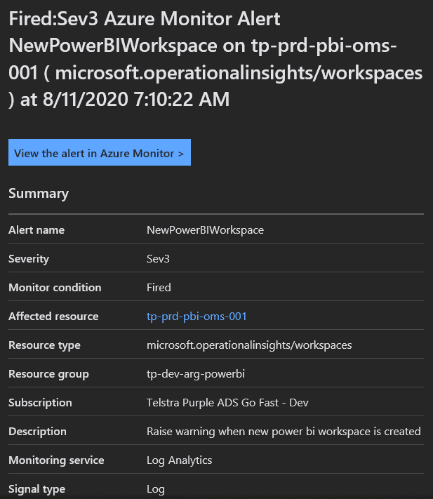
Receive email, sms, push, voice alerts
Alerts
Enforce organizational policies

Slide 48
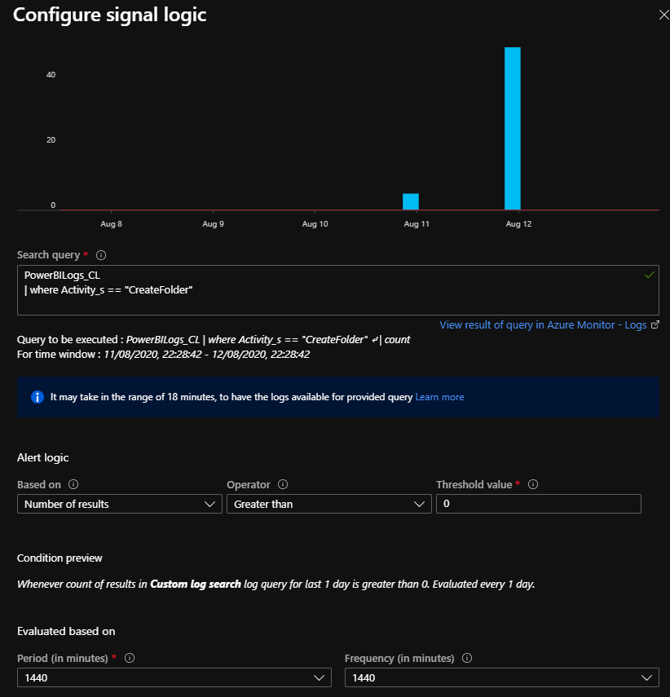
Configure search queries
Alerts
Easily configurable
Configure condition
Configure period and frequency

Slide 49
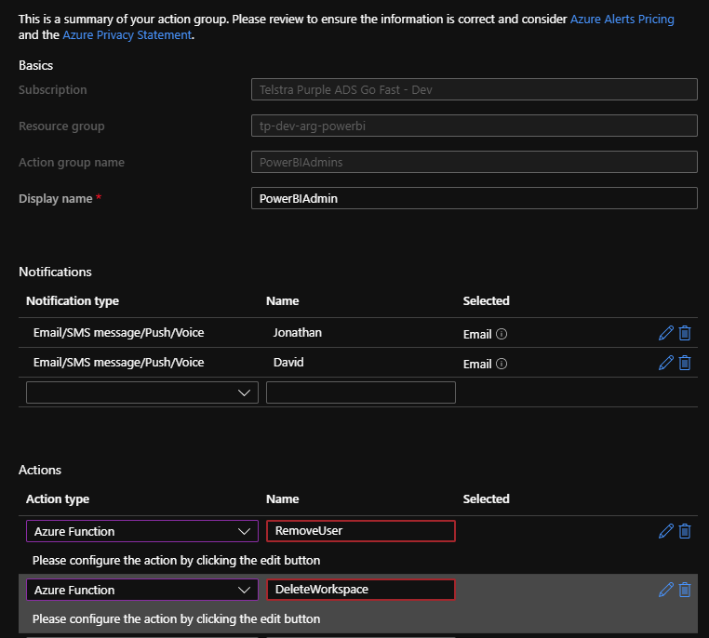
Configure notifications
Notifications and Actions
Easily configurable
Configure actions e.g. RemoveUser, DeleteWorkspace

Slide 50
Training

Slide 51





Training
Agile Enterprise BI Training
Power BI Foundations Training
Git Fundamentals
Power BI Administration
Agile Enterprise BI DevOps
Objective | Provide BI Developers with the knowledge on how to operate within the Agile Enterprise BI framework.
Target audience | Corporate BI Team Power BI Admins This course is not intended for Self-Service users.
Duration | 3 hours
Objective | Enable BI Developers to understand the core components of the Power BI Platform, and acquire skills to develop content end-to-end.
Target audience | Corporate BI Team This course is not intended for Self-Service users.
Duration | 4 hours
Objective | Provide BI Administrators with the knowledge and skills on how to administer Power BI, including the Agile Enterprise BI monitoring and alerting features.
Target audience | Corporate BI Team Power BI Administrators This course is not intended for Self-Service users.
Duration | 2 hours
Objective | Provide BI Developers with the skills to use Git, a version control system that serves as the bedrock to CI/CD processes.
Target audience | Corporate BI Team This course is not intended for Self-Service users.
Duration | 3 hours
Objective | Provide BI Developers with the knowledge and skill to utilize DevOps boards, Repos and Pull Requests, and the CI/CD process deployed as part of Agile Enterprise BI.
Target audience | Corporate BI Team This course is not intended for Self-Service users.
Duration | 2 hours

Slide 52
Appendix

Slide 53


References
Resource | URL
Icons from Pixel Perfect | https://www.flaticon.com/authors/pixel-perfect
Icons from Freepik | https://www.flaticon.com/authors/freepik https://www.flaticon.com/packs/profession-avatars
Stock images | https://unsplash.com/

Slide 54
Thank you

